Slide 1
IEEE 802.11ay Next Generation 60 GHz Communication for 100 Gb/s WiFi

Slide 2




Kadir Emre Oto
otok@itu.edu.tr
BLG433E
Computer
Communications
2018-2019 Fall Term
Prof. Dr. Sema Oktuğ
Korel Chairoula
chairoulak@itu.edu.tr
Muhammed Burak Buğrul
bugrul@itu.edu.tr
Mustafa Efekan Pekel
pekelm@itu.edu.tr

Slide 3
ABSTRACT
IEEE 802.11ay Task Group has defined new PHY and MAC specifications that enable 100 Gb/s communications due to enabling multi-Gb/s wireless local communications and reliability requirements of new applications such as AR/VR.
In this paper presentation, we are describing main design elements of IEEE 802.11ay.

Slide 4
INTRODUCTION
While wireless technologies evolving, new applications and usage growth demand greater throughput and reliability with lower latencies.
IEEE 802.11ay Task Group was formed in 2015 in order to define PHY and MAC amendments that enable Wi-Fi devices to achieve 100 Gb/s using 60 GHz band.
DMG (Directional Multi-Gigabit) and EDMG (Enhanced Directional Multi-Gigabit) stations refer to devices that can support features of 802.11 and 802.11ay standards, respectively.

Slide 5
Channel Bounding and Aggregation
IEEE 802.11ad only allows for single (2.16 GHz) channel transmission. 802.11ay includes mechanisms for channel bounding and aggregation.
In channel bounding, a single waveform covers at least two 2.16 GHz channels, whereas channel aggregation has a separate waveform for each channel.
IEEE 802.11ay mandates that EDMG STAs must support operation in 2.16 GHz channels. Channel aggregation of two channels and bonding of there or four 2.16 GHz channels optional.

Slide 6
Directional MIMO Communication
To achieve both beamforming and multiplexing gain, 802.11ay defines new mechanisms to enable MIMO operation including Single-User MIMO (SU-MIMO) and Multi-User MIMO (MU-MIMO).
802.11ay also supports stations with dual-polarized antenna arrays. It allows for diversity gains and multiplexing in line-of-sight environments.
MIMO link supports is determined by different factors including the environment, the directivity of the antenna used and on whether antenna polarization is exploited.

Slide 7
IEEE 802.11AY PHYSICAL LAYER

Slide 8
EDMG Packet Format
A single packet format is defined for the three EDMG PHY modes: SC (single carrier), OFDM (orthogonal frequency division multiplexing) and control.
Not all fields are transmitted in EDMG packet. Some are used for single channel or channel bonding, SISO or MIMO transmission or beamforming training/ tracking.

Slide 9
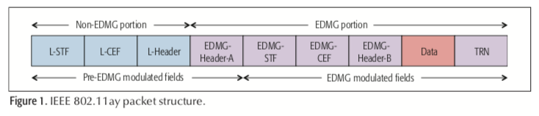
Non-EDMG Portion
Non-EDMG portion allows backward compatibility.
L-STF & L-CEF for packet detection, carrier frequency earning and timing
L-Header field is the same as the header field of 802.11ad packet, however some of its bits redefined.

Slide 10
EDMG Portion
Only recognized by EDMG STAs
EDMG-Header-A field carries information to interpret EDMG packets (bandwidth, modulation, coding scheme, spatial streaming).
EDMG-STF and EDMG-CEF enable stations to estimate various signal parameters and the channel when channel bounding or MIMO utilized.
EDMG-Header-B is only included in MU-MIMO packets.

Slide 11
Data Field Format
The data field consists of the payload data and possible padding (0s).
SC block size consists of 512 x N_{CB} symbols, N_{CB} is the number of utilized 2.16 GHz channels.
The control mode allow low SNR operation prior to beamforming (MCS 0).
Other MCS are based on BPSK, QPSK, 16 and 64 QAM modulations and LDPC codes with different rates
The achievable data rate for each MCS index depends on the number of spatial streams.

Slide 12
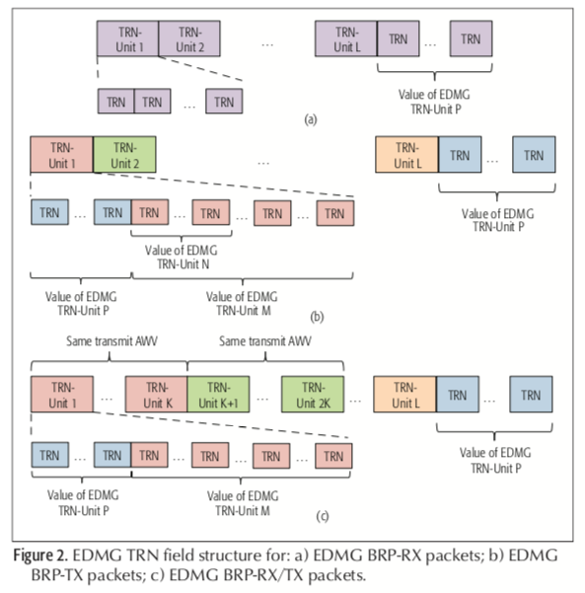
Training Field Format
TRN field allows to transmit and receive beamforming training.
BRP (Beam Refinement Protocol) is a process to be able to improve its antenna configuration for transmission and reception.
TRN field redesigned in 802.11ay to increase efficiency and make it configurable.

Slide 13
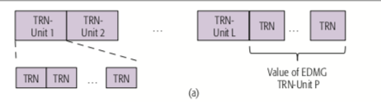
Training Field Format
In a BRP procedure, all TRN subfields are transmitted with the same antenna weight vector (AWV) as the data field.
AWV is vector of weights describing the excitation for each element of an antenna array.
This configuration allows receiver to switch AWVs when receiving different TRN subfields and determine an improved antenna configuration setting.

Slide 14
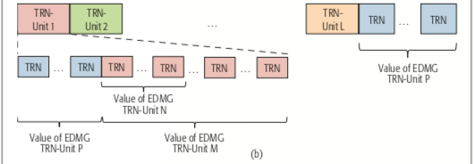
Training Field Format
In a BRP procedure, transmitter uses different AWVs in the transmission of the TRN field while the receiver uses same AWV.
Three parameters define the format of a TRN-Unit used for transmit beamforming training.
EDMG TRN-Unit P, EDMG TRN-Unit M, EDMG TRN-Unit N

Slide 15
Training Field Format
P transmits the TRN subfields at the same AWV in which the receiver uses this info to synchronize and estimate the channel
M enhances the robustness of the beamforming training process (may be transmitted with the same AWV over and over again)
N is the number of sequential TRN subfields with the same AWV

Slide 16
IEEE 802.11AY MEDIUM ACCESS CONTROL LAYER

Slide 17
Beacon Interval
Two main access periods:
beacon header interval (BHI)
data transmission interval (DTI)

Slide 18
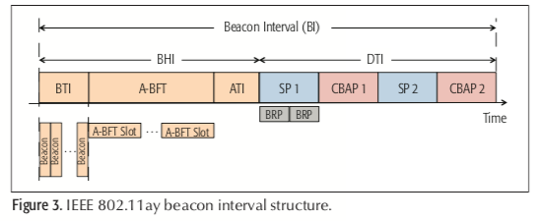
Beacon Header Interval
Beacon transmission interval (BTI)
Association beamforming training (ABFT)
Announcement transmission interval (ATI)

Slide 19
Multiple Channel Access
To facilitate the coexistence of EDMG STAs with DMG STAs, the channel width of the primary channel is 2.16 GHz.
To enable the coexistence of DMG and EDMG STAs, network announcement and management frames need to be transmitted through primary channel.

Slide 20
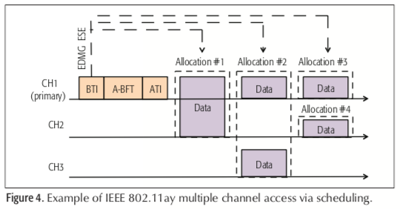
Multiple Channel Access Through Scheduling

Slide 21
MIMO Channel Access
To perform a MIMO transmission, transmitter must obtain TXOP.
To this end, EDMG STAs that support MIMO maintain physical and virtual carrier sensing and perform the backoff procedure.

Slide 22
IEEE 802.11AY BEAMFORMING CONTROL

Slide 23
BF Training
Beamforming training is used to determine the appropriate transmit and receive antenna configurations for a pair of stations through two sub-phases.
IEEE 802.11ay includes several new beamforming training protocols, including SU-MIMO/MU-MIMO beamforming training, BRP transmit sector sweep and beamforming for asymmetric links.

Slide 24
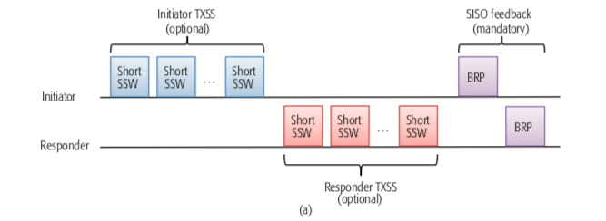
SU-MIMO Beamforming
SU-MIMO BF protocol consists of two consecutive phases: SISO phase and MIMO phase.
SISO Phase: In this phase, both STAs collect the necessary feedback for possible candidate sectors.

Slide 25
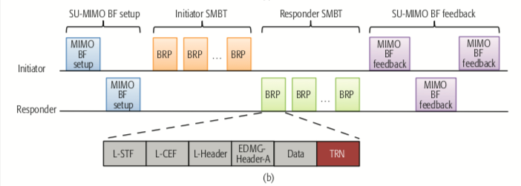
SU-MIMO Beamforming
MIMO Phase enables the simultaneous training of transmit and receive sectors for each DMG antenna.
Four mandatory sub-phases:
SU-MIMO BF Setup, SU-MIMO BF training (SMBT), responder SMBT, SU-MIMO BF feedback

Slide 26
MU-MIMO Beamforming
MU-MIMO BF enables an initiator and a group of responders to determine appropriate antenna configurations for simultaneous transmission of multiple data streams with minimum inter-stream interference.
802.11ay only supports downlink MU-MIMO transmission.

Slide 27
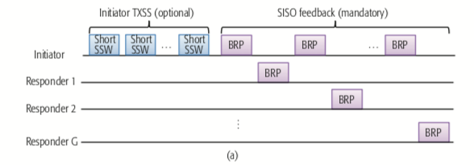
MU-MIMO Beamforming
SISO Phase

Slide 28
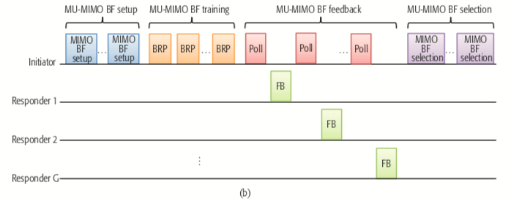
MU-MIMO Beamforming
MIMO Phase

Slide 29
CONCLUSION
IEEE 802.11ay advances provide opportunities for new research topics:
Design and experimental analysis of MIMO policies under different LoS and non-LoS conditions, different antenna directivities and with single-polarized or dual-polarized transmissions.
Design and implementation of adaptive dual-polarized arrays .
Design of low-power and low-complexity MIMO architectures for milimeter-wave that allow for flexible analog and digital beamforming and digital beamforming and advanced signal processing techniques.

Slide 30

THANKS!

